Slide 1
Correlation
Module 6

Slide 2
Module Objectives
Upon completion of this module, you will be able to:
Define the SIEM functional stack.
Define the normalization process and its criticality within the event correlation process.
Define event correlation.
Configure and deploy custom correlation rules within the McAfee correlation editor.

Slide 3

Module Topics
The SIEM Functional Stack
Normalization
Event Correlation
Receiver Event Correlation Configuration
Add a correlation component
Roll out correlation policy
Edit correlation rules
Create custom correlation rules
McAfee ACE Overview

Slide 4
The SIEM Functional Stack
Reporting
Normalization
Event Collection
Correlation
Notes:
The SIEM functional stack is an important concept to understand when implementing a SIEM solution. Each layer of the SIEM functional stack performs a specific function that makes up the total SIEM solution.
The Event Collection Layer is where you collect logs and other event messages from systems from within your environment.
The Normalization Layer is where related messages that are formatted differently are converted to a common syntax and grouped together into a common taxonomy.
The Correlation Layer is where events are co-related to each other to create incidents.
The Reporting Layer is where output is created and/or actions taken based on the processing of the events that have been input into the SIEM.

Slide 5
Event Normalization
The act of changing different types of logs into a single format is called Normalization
No standard LOG format exists, therefore different devices and applications will report similar events with different event messages for example: Cisco ACS Login Success Event: Jul 16 22:45:27 69.20.1.10 CisACS_01_PassedAuth err8eir4 1 0 Message-Type=Authen OK,User-Name=antonio lester,NAS-IP-Address=69.20.45.1,AAA Server=acs01, F5 Firepass VPN Login Success Event: Jul 16 22:46:32 <13>security[9600]: [presslauer@Nitro] User presslauer logged on from 69.20.234.69 Sid = df675
SIEM Normalization will covert these messages into a common syntax like this: Date Time SIP Message EventID Jul 16 22:45:27 69.20.1.10 User Login ACS-123456 Jul 16 22:46:32 69.20.234.69 User Login F5-123456
Normalization enables event correlation to occur on a common taxonomy that represents the higher order of similar but unique event messages
Notes:
Now we know that the logs from a multitude of devices and applications will be forwarded into the SIEM and that these logs will still be in their native format. We really have not gained anything in this process yet besides a centralized repository for our logs. So what needs to happen next is for these logs to be reformatted into a standard format using event normalization, which is the act of changing different types of logs into a single format. Normalizing the events not only makes it simpler to read these logs, but also makes it easier and allows for a standard format of correlation rule generation.

Slide 6
Event Correlation
Event correlation brings a higher level of intelligence and situational awareness into security operations management
This is done by teaching the SIEM to consider various defined conditions or patterns of interest
For Example: A server running at 100% CPU utilization could be caused by different things such as:
A misconfiguration
Failed Application
Resource overload due to legitimate activity
A denial-of-service attack
Malware, Virus, or Worm
To answer these questions a SIEM can be configured to consider the following using correlation logic
Has antivirus software detected any activity on the server
Are there any other servers in the environment reporting similar activity
Are there any applications on the server that have reported an error
Depending on the answer to these questions the SIEM’s Alert and our actions will differ
Notes:
Event correlation brings a higher level of intelligence into a security operations environment. We don’t just see a single event and then choose to react or not react. With event correlation, we teach the system to consider various conditions before an alarm is triggered.

Slide 7
Event Correlation Engine
The rule based correlation engine expands upon the normalization of events from different sources in order to trigger alerts within the SIEM based on a defined condition or conditions being met
Boolean logic is used to determine if specific conditions are met and examine pattern matching within the data fields themselves
Example Correlation Engine Logic for Remote Local Admin Login Events
Alert: Local Admin Remote Login
YES
YES
Remote Login?
Administrator?
Root?
User: Login UserID: root
YES
NO
NO
Exit Process
NO

Slide 8
Receiver Correlation Overview
A single correlation data source is assigned to a receiver.
Only one correlation data source can be configured per receiver.
A correlation data source analyzes data flowing from an ESM, detects suspicious patterns within this data, and creates correlation alerts.
These alerts are inserted into the Receiver’s alert database.
A suspicious pattern is represented by data interpreted by correlation policy rules
These types of rules are separate and distinct from IPS or Firewall rules and have attributes that specify their behavior.
Once you have configured a Receiver's correlation data source
You can roll out the correlation’s default policy
Edit the base rules in this correlation's default policy
Add custom rules and components and then roll out the policy.
You can enable or disable each rule and set the value of each rule's user-definable parameters.

Slide 9
Advanced Correlation Engine
The McAfee Advance Correlation Engine (ACE) is a dedicated appliance that can be deployed alongside the ESM to provide dedicated correlation logic that supplements the ESM's existing event correlation capabilities.
It can be deployed in either real-time or historical modes.
When operating in real-time mode, events are analyzed as they are collected for immediate threat and risk detection.
In historical mode, any available data collected by the ESMI can be “replayed” through either or both correlation engines, for historical threat and risk detection.
That means that when new zero-day attacks are discovered, the ESMI can look back to determine whether or not the organization was exposed to that attack in the past, for “sub zero day” threat detection.

Slide 10
Advanced Correlation Engine - Risk
ACE is a risk detection engine that generates a risk score using rule-less correlation
Detection signatures are replaced with a simple, one-time configuration telling the Risk Correlation engine what is important to your business.
This could be a particular service or application, a group of users, specific types of data or any combination of these options.
Risk Correlation tracks all activity related to those items, building a dynamic risk score that raises or lowers based upon real-time activity.
When a risk score exceeds a certain threshold, an event is generated
This event can be used to alert you to growing threat conditions, or it can be used by the traditional rule-based correlation engine as a condition of a larger incident.
The ESMI keeps a complete audit trail of risk scores to allow full analysis and investigations of threat conditions over time.

Slide 11









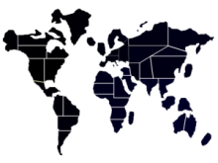




Content, Context and Risk Correlation
Application Contents
Authentication & IAM
Events from Security Devices
User Identity
Device & Application Log Files
Malware
Viruses
Trojans
Insider Threats
Advanced
Threats
Exploits
Database Transactions
Location
OS events
VA Scan
Data
Notes:
You get rule-based correlation of real-time event data for detection of threats as they occur or rule-less correlation of real-time event data for detection of threats as they develop.
Model your enterprise risk
Provide impeccable modeling of your organizations risks by scoring attributes that matter. Develop a baseline and send notifications when normal thresholds are exceeded.
Leverage proactive risk assessments against critical data
Use both correlation engines simultaneously to detect risks and threats before they occur, so you can use risk scores within traditional correlation logic.

Slide 12
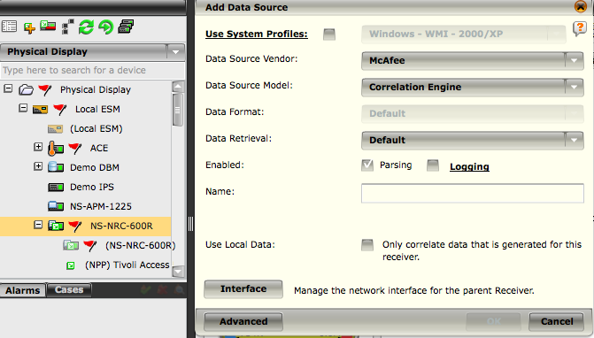
Add a Correlation Data Source
NOTE
Use Local Data: If this checkbox is not selected, the ESM will correlate data on all the devices on the system
Notes:
In the System Navigation Tree click on a Receiver and click on the Add Data Source icon in the Actions Toolbar. The Add Data Source dialog appears as above
Click on the down arrow next to the Data Source Vendor field and select McAfee.
In the Data Source Model field, click on the down arrow and select Correlation Engine.
Enabled - Click on Parsing, Logging, and/or SNMP Trap, or leave the checkboxes blank.
In the Name field, enter a name for your correlation data source.
In the Use Local Data field, click on the checkbox if you want this device to only correlate data that is generated by this receiver.
Click OK to save the changes.

Slide 13
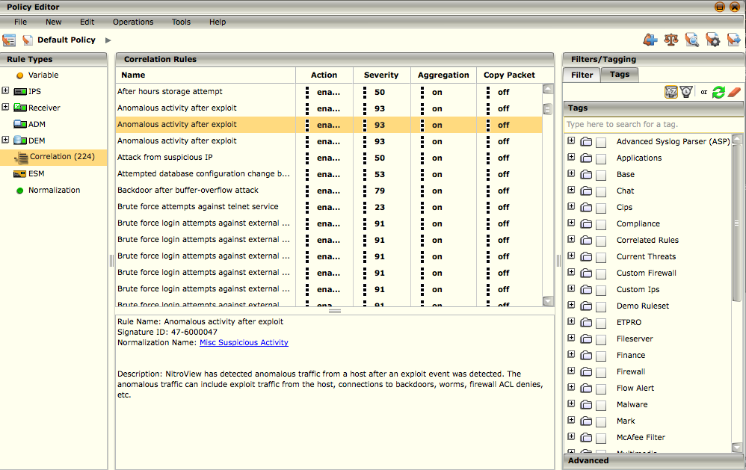
Rollout Correlation Policy
Once a correlation data source has been created we need to review the default rule set to enable or disable rules that make sense for our environment.
By default the McAfee correlation policy comes with several hundred correlation rules to support a wide range of needs.
NOTE
This is different then writing data source settings to the receiver.
Writing the data source settings does not rollout the correlation policy.
Notes:
After creating a correlation data source, you must roll out the policy in order for the new data source to be enabled.
In the System Navigation Tree, click on the correlation data source you created.
Select the Policy Manager icon in the Actions Toolbar. The Policy Manager dialog will appear.
In the Policy Manager dialog, the new correlation data source should already be highlighted if not, you can find it in the tree and select it.

Slide 14
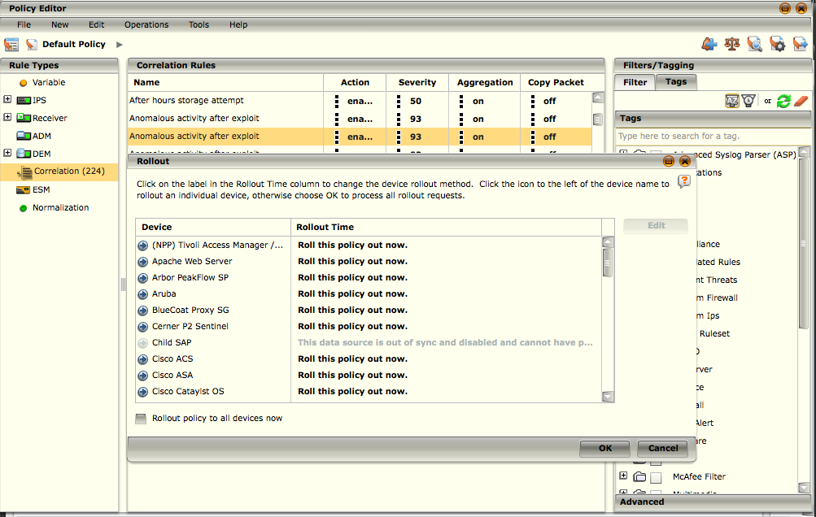
Rollout Correlation Policy
1
Rolling Out Policy
Select Operations Tab, Select Rollout. This will open the Rollout Dialog Box.
This will rollout the correlation policy to the receiver or receivers, establishing or updating it; and activating any changes
2
NOTE
The Rollout dialog box will update automatically to show the current status of the rollout process
Notes:
Applying a rollout activates the data source so you can start viewing the information your data source has collected.

Slide 15

Correlation Rule Editor
The fundamental purpose of the Receiver Correlation Subsystem (RCS) is to analyze data flowing from ESMs, detect interesting patterns within the data flow, generate alerts that represent these patterns, and insert these alerts into the Receiver's alert database.
The Correlation Rule Editor allows you to turn off existing rules, modify them, or create new ones.
The base rules can’t be modified, and must be copied in order to be modified.
The correlation rule editor can be accessed via the quick links section, by clicking the correlation icon.
It can also be accessed through the policy editor, under data sources then correlation.

Slide 16
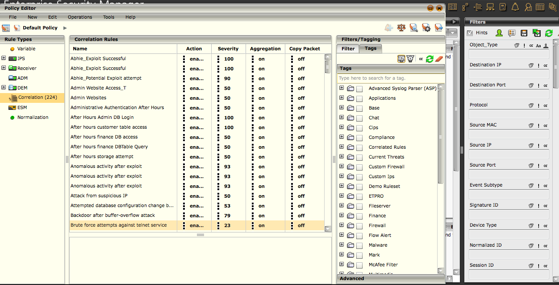
Correlation Rule Editor
The following default settings can be configured or modified from the policy editor screen:
Severity
Action
Aggregation
Copy Packet
NOTE
The Receiver Correlation Subsystem is only enabled and visible when a Correlation Data Source has been configured.
Notes:
Once you access the policy editor, you will find correlation under the Data Sources tab.
If you have multiple correlation policies for individual receivers, select the appropriate policy in the ‘Current Policy’ pull down menu.
You can find correlation under the Correlation Folder, and then by highlighting correlation Engine if not already selected.
You can create a new rule under the New option on the menu bar.
You can copy an existing correlation rule by highlighting the rule and using the copy → paste options under the edit option.

Slide 17
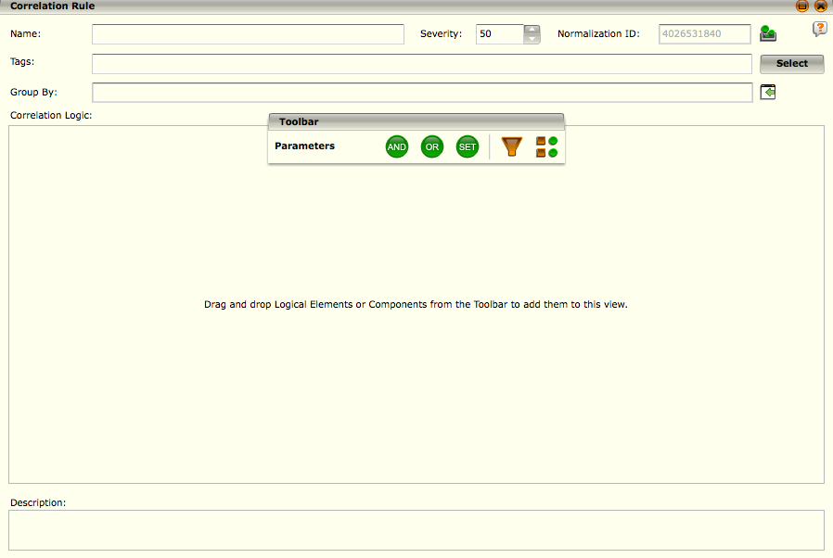
Correlation Rule Editor - Overview
The correlation rule editor is a graphical correlation rule builder that lets you drag and drop components, add filters and parameters, and set values to have the desired effect and set meaningful alerts.
The Toolbar on the Correlation Rule Editor provides the tools needed to build the rule. It allows you to define parameters for the rule as well as build the rule's logic using logical elements and components.
Notes:
From the front screen, you set the following 3 parameters:
Name – This is the name that will show when the rule fires and shows in the UI.
Severity – A value between 1 and 100, indicating the severity of the alert.
Normalization ID – Indicates the normalized group the rule belongs to. By default, it is set to uncategorized.
Tags – Add a tags to the correlation rule for grouping and organization purposes.

Slide 18

Correlation Rule Editor – Logic Elements
AND Logic Element:
This element functions the same as the logical operator “and” in a computer language.
Everything that is grouped under this logical element must be true in order for the condition to be true.
Use this option if you want all the conditions under this logical element to be met before a rule is triggered.
This element will appear as seen below when it is dropped in the Correlation Logic area.
Filter A | Filter B | Output
False | False | False
False | True | False
True | False | False
True | True | True

Slide 19

Correlation Rule Editor – Logic Elements
OR Logic Element:
This element functions the same as a logical “or” operator in a computer language.
Only one condition grouped under this element has to be true in order for this condition to be true.
Use this element if you want only one condition to be met for a rule to be triggered.
This element will appear as seen below when it is dropped in the Correlation Logic area.
Filter A | Filter B | Output
False | False | False
False | True | True
True | False | True
True | True | True

Slide 20
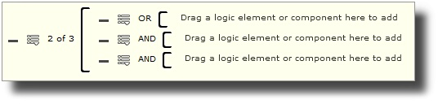
Correlation Rule Editor – Logic Elements
SET Logic Element:
This element allows you to define more than one condition and select the number of conditions that must be true for the rule to be triggered.
For example, if you have 3 conditions in the set and 2 of them must be met for the rule to be triggered, the set will read "2 of 3”

Slide 21
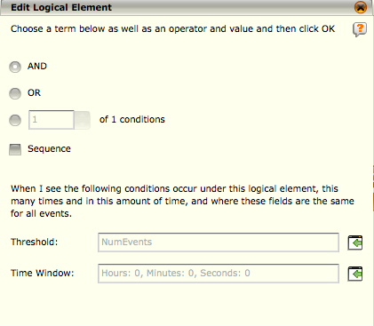
Correlation Rule Editor – Edit Logic Element
If you want to change the default settings of an AND, OR, or SET logic element on the Rule Editor, you will need to access the Edit Logical Element screen.
The Edit Logical Element dialog allows you to do the following:
Change Element Type
Select number of conditions to be met
Define a sequence for the elements
Notes:
The top section of the Edit Logical Element dialog gives you the following options:
Change the element type - The element type radio button that is selected by default is the one that reflects the logical element that you dragged and dropped. In other words, if you dragged and dropped the AND logical element icon, the AND radio button will be selected on the Edit Logical Element dialog. You do have the option to change that setting to a different type if needed. This option is particularly helpful if you have set up a rule or component with several layers of logic elements and then realize that one of the elements at the beginning of the logic diagram should be a different type.
Select number of conditions that must be met - This option allows you to select how many of the conditions that are part of the SET logic element must be met in order to trigger the rule. The number can only be changed when the SET has more than one condition. The total number of conditions available in the SET will be shown in the ...of _conditions statement. When you select this option by clicking on the Sequence checkbox, the elements or components that you add to this logical element will be numbered (see figure). You can change the order of the elements or components by clicking and dragging them to the desired position
Define a sequence for the elements - This option allows you to define the order in which the conditions of a logical element need to occur for the rule to be triggered. You can apply a sequence requirement to the AND and SET logical elements. When you select this option by clicking on the Sequence checkbox, the elements or components that you add to this logical element will be numbered (see figure). You can change the order of the elements or components by clicking and dragging them to the desired position.

Slide 22
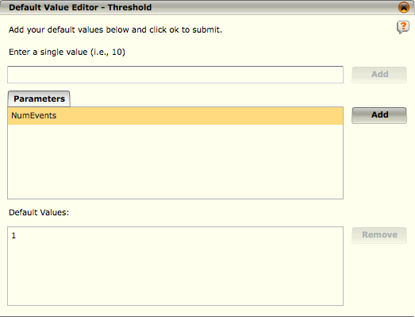
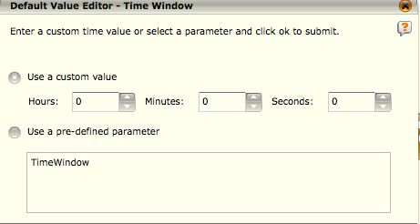
Correlation Rule Editor – Default Value Editor
Threshold: Allows you to define how many times the conditions need to occur for the rule to be triggered.
Time Window: Allows you to set the period of time in which the count needs to occur.
Notes:
Default Threshold is set to 1 and Time Window is set to 10 minutes.
If you want to change the default settings, click on the icon to the right of each field. The Default Value Editor for each value will open. In this example, the parameter, “NumEvents” is selected. This is a pre-configured value which can be re-used as often as you need in Correlation rules. This value can be re-set to a different value, deleted or new ones created.

Slide 23


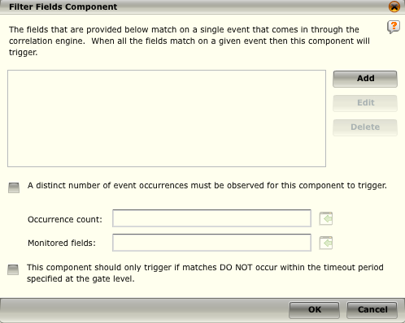
Correlation Rule Editor - Filters
Filter: This node gives you the ability to filter on the fields included in events.
Fields that are added via the “add” button match on a single event when it is processed by the correlation engine
When all the fields match on a given event then this component will trigger
It is recommended to create very granular filters to reduce false positives and optimize the correlation engine for peak performance
Notes:
Filter - When you drag and drop this icon into a logic element in the Correlation Logic area, the Filter Fields Component screen opens. This screen will be blank until you add filter fields.

Slide 24
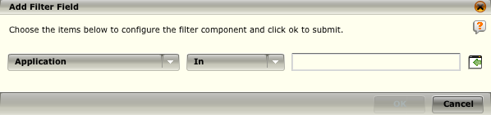
Correlation Rule Editor – Add Filter
Application
Application_Protocol
Command
Contact_Name
Contact_Nickname
Context
Database Name
Day of Week
Destination Geolocation
Destination IP
Destination MAC
Destination Network Device
Destination Network Interface
Destination Port
Destination User
Destination Zone
Device Class
Device ID
Device Type
Device Vendor
Domain
End_Page
Event Subtype
External IP
File_Operation
File_Operation_Succeeded
Host
Internal IP
Method
Normalization Rule
Num_Copies
Object
Object_Type
Protocol
Response_Time
Session
Severity
Signature ID
Source Geolocation
Source IP
Source MAC
Source Network Device
Source Network Interface
Source Port
Source User
Source Zone
Start_Page
Time of Day
User_Name
Notes:
The correlation rule editor allows you to filter on one or more of any of the available fields within the McAfee SIEM database to include any user defined fields that may have been defined.

Slide 25
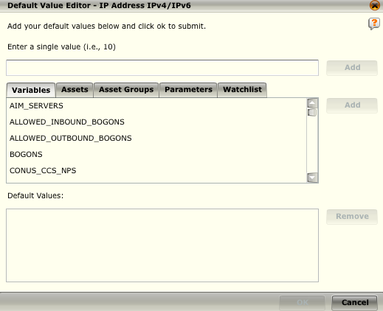
Correlation Rule Editor – Default Value Editor
When you are adding a parameter to a correlation rule or component, you will need to select the default value(s) for the parameter.
The available default value options will vary based on the type of parameter selected.

Slide 26
Correlation Rule Editor – Filter Component
If you want a specific number of unique values for a particular field to occur before the component triggers, click on the A distinct number of... checkbox and select the Occurrences and Monitored fields parameters.
For example, if you want there to be 2 events, each with a different source user, you would set 2 in occurrence count and Source User in Monitored fields.
If you want the component to trigger only if matches do not occur within the time period specified in the Time Window field at the gate level, click on the This component should only trigger... check box.

Slide 27

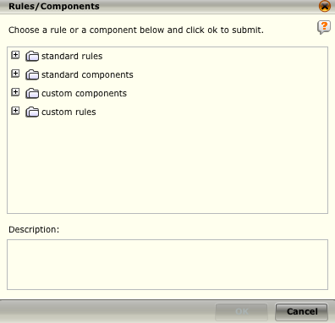
Correlation Rule Editor – Rules/Components
Rules/Components: allows you to reference a standard or custom rule or component inline.
Standard rules refer to the built in McAfee correlation rules
Standard components refer to built in event flow directions to aid in creating complex event flow definitions
Customer components refer to any component that has been edited from it’s default values
Customer rules refer to any user generated correlation rules already defined within the policy editor
Notes:
Rules / Components - When you drag and drop this icon into the Correlation Logic area, the Rules/Components screen opens, listing the rules and components that can be referenced from this correlation rule or component. Highlight the one that you want to add to the rule or component and click OK.

Slide 28
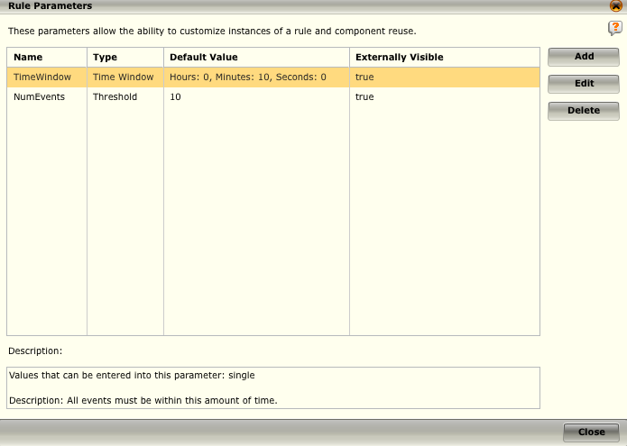
Correlation Rule Editor - Parameters
When you are adding a parameter to a correlation rule or component, you will need to select the default value(s) for the parameter.
The available default value options will vary based on the type of parameter you have selected.
Notes:
The parameters of a rule or component control the behavior of the rule or component when it executes. However, parameters are not required. To add parameters:
Click on Parameters on the Correlation Rule Editor or Correlation Component Editor Toolbar. The Parameters table will open. Since this is a new rule or component, no parameters will be listed.
Click on the Add button. The Add Parameter dialog will open.
Enter a name for the parameter in the Name field.
Select the type of parameter you want this to be by clicking on the down arrow in the Type field. The values available for the type selected will be enabled.
The available values will be checked. Click on the checkbox if you want to disable either of the values.
If you select List and Range values, keep in mind that both value types cannot be used at the same time. For example, if the rule uses a list value (e.g., 8, 10, 13) it cannot also include a range (e.g., it cannot say 1-6 8, 10, 13). It would need to be written as only a list (e.g., 1, 2, 3, 4, 5, 6, 8, 10, 13).
Select the default value for the parameter by clicking on the icon to the right of the Default Value field (). The Default Value Editor dialog for the type of parameter selected in the Type field will open.
All new parameters are externally visible by default. If you do not want the parameter to be externally visible, deselect the Externally Visible checkbox by clicking on it. The parameter will then be local to the scope of the rule.
Type in a description of this parameter in the Description field. It will show up in the Description box on the Parameter Table screen whenever this parameter is highlighted.

Slide 29
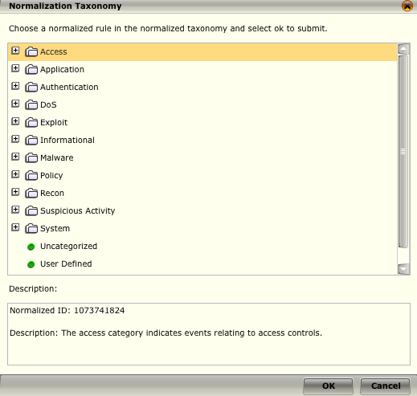
Correlation Rule Editor - Normalization
Rules are named and described by each vendor.
As a result, the same type of rule will often have various different names, making it difficult for the user to gather useful information regarding the types of events that are occurring.
McAfee has compiled, and will continually update, a list of Normalized IDs that describe rules so that events can be grouped into useful categories.
Notes:
Even correlation rules should be normalized as a part of the functional SIEM stack. The output of a correlation rule is an event and these events should be processed within the functional SIEM stack just as any other event.

Slide 30
Creating a Custom Correlation Rule
Criteria: Create a correlation rule that will trigger on a successful login to any system from an external network using the local administrator account or root account. Note this was the correlation logic we described earlier!
Alert: Local Admin Remote Login
YES
YES
Remote Login?
Administrator?
Root?
User: Login UserID: root
YES
NO
NO
Exit Process
NO
About the Course

Slide 31
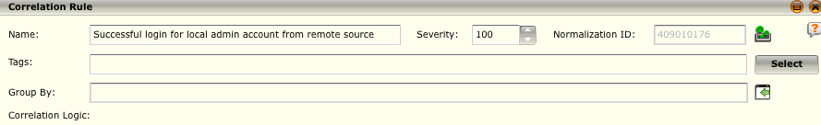
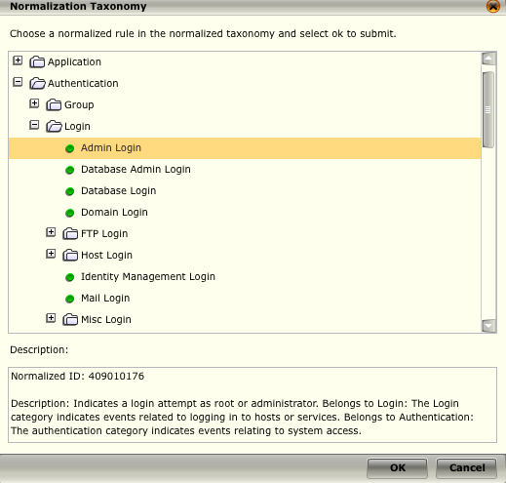
Create a Custom Correlation Rule
We need to open the rule editor and give our rule a descriptive name:
We set a severity of 100, as this is a serious policy violation in our environment
Next we select a normalization category in this case we choose: Authentication->Logon->Admin Login

Slide 32
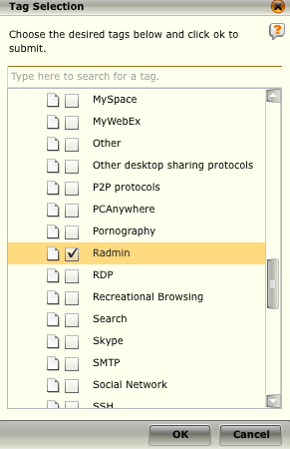
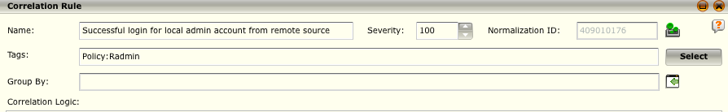
Create a Custom Correlation Rule
To make this rule easy to find we decide to tag it as a Remote Admin Policy Violation.

Slide 33
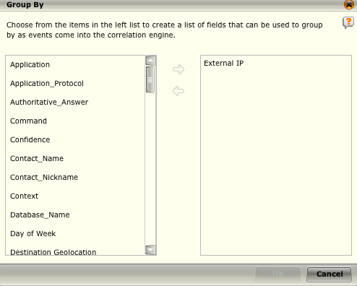

Create a Custom Correlation Rule
It makes sense for us to group by external IP addresses for this event, as we are looking for an external IP logging into a local network server using an admin account. Note: We could have just as easily grouped by Source IP address.

Slide 34
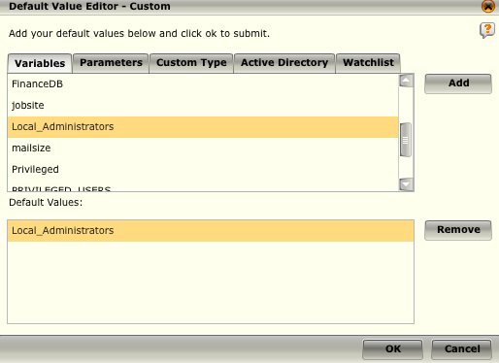
Create a Custom Correlation Rule
We add a predefined filter for the Source User field that defines the local administrators as “Administrator” and “root”

Slide 35
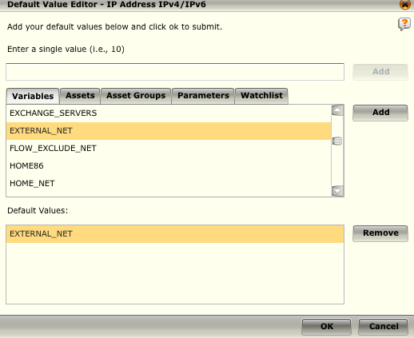
Create a Custom Correlation Rule
We add an additional built in filter for the Source IP field that defines our external network. Note the EXTERNAL_NET variable is the NOT value of our HOME_NET definition.

Slide 36
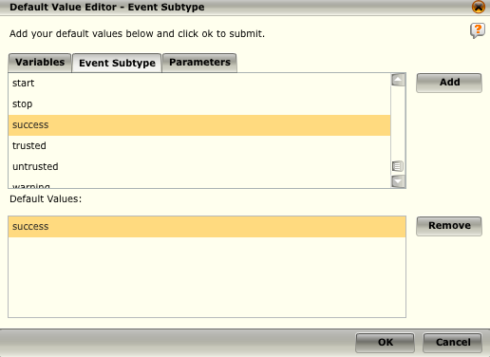
Create a Custom Correlation Rule
The last filter we need to add is to detect successful login events for these accounts. To do this we add a filter for the Event Subtype field and select the success subtype

Slide 37
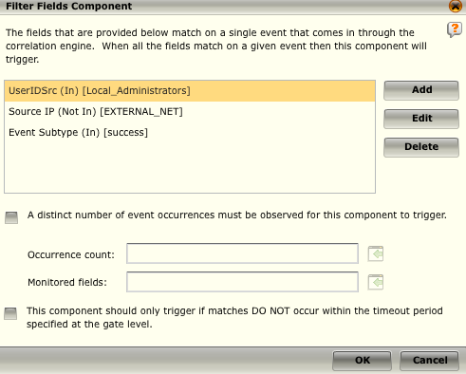
Create a Custom Correlation Rule
Our filters can now be seen in the Filter Fields component and all we need to do is select the OK button to create our filter within the correlation rule.

Slide 38
Create a Custom Correlation Rule
The resulting filter can now be seen within the correlation editor as seen below:
Now compare this filter logic to our original SIEM correlation block diagram:
Alert: Local Admin Remote Login
YES
YES
Remote Login?
Administrator?
Root?
User: Login UserID: root
YES
NO
NO
Exit Process
NO
About the Course
Notes:
The last step is to save our correlation rule and roll out policy. Notice that although our order of checks within the filter built the end result is the same as our diagram.

Slide 39
Which of the following components make up the functional SIEM Stack?
Reporting
Normalization
Data Processing
Event Collection
Correlation
Mitigation
Notes:
Answer: Event Collection, Normalization, Correlation, and Reporting

Slide 40
The act of changing different types of logs into a single format is called ____________ ?
Correlation
Reporting
Normalization
Aggregation
Event Collection
Notes:
Answer: Normalization

Slide 41
The Receiver Correlation Subsystem is only enabled and visible when a Correlation Data Source has been configured.
True
False
Notes:
Answer: True

Slide 42
Hands-on Practice Refer to the Practice Manual Practice 6: Correlation Rules

